Slide 1
Assessment
Dr Ramesh Mehay
TPD Bradford GP Training Scheme
And its alignment

Slide 2
Exercise
Useful questions to think about
What is assessment?
What do we want to achieve?
How do we measure success?
How do we know that the measure of success is the right one?
In groups – 5 minutes
Define assessment and think about different types of assessment YOU have undergone – write on flipchart.
What we do know is that assessment leads to anxiety…

Slide 3
Definition
Processes and instruments applied to measure learning achievements

Slide 4
Matching method of assessment to ILO
Constructive alignment
Why does the driving test have a theory and the practical?
Isn’t the practical good enough?
Can you link this with Bloom’s taxonomy?
Notes:
Constructive alignment: the selected method is clearly linked with the objective to be tested
Example: Driving test - two components, theory and practical
Content and method are matched to the desired outcomes – that an individual understands the Highway code, can recognise and respond to hazards and demonstrates practical driving skills at a pre determined level of competence

Slide 5
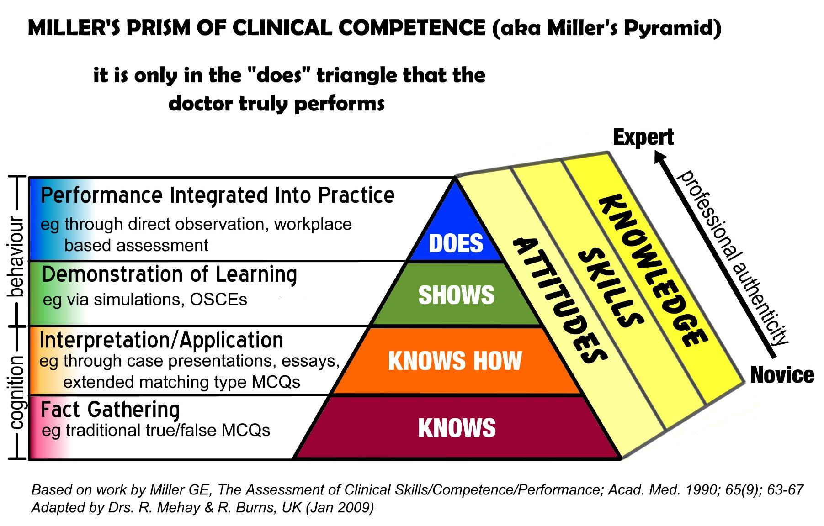
Miller’s Pyramid

Slide 6
CONSTRUCTIVELY ALIGNING A NEW TEACHING SESSION
Designing a teaching session – the ACME way
A is for setting Aims & Intended Learning Outcomes (ILOs)
C is for defining Content
M is for exploring Methodologies
E is for the Ending (= Summarising, Evaluation, Assessment & future Learning)
And it works like this:
Define the Aims and ILOs (A). This is the most crucial step. Then:
Use the Aims & ILOs (A) to define the Content (C)
Use the Aims & ILOs (A) to select the Methodology (M)
Use the Aims & ILOs (A) to construct the Evaluative Assessment (E).

Slide 7
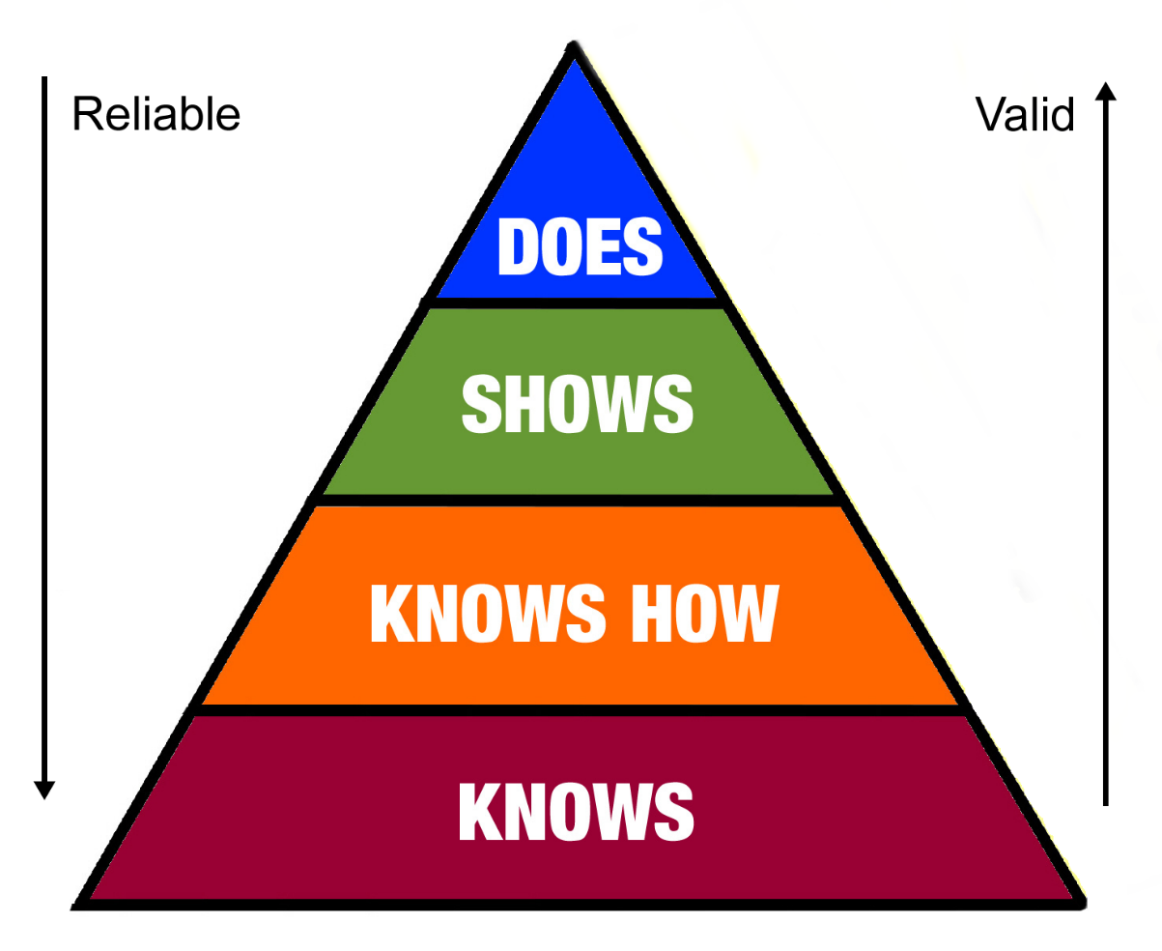
Assessments need to be reliable and valid.
Reliable? (competence level)
Valid? (Bloom, Miller)
Inverse relationship.
Notes:
Reliability (the consistency with which a test will produce similar results)
How do we know a test-score is reliable?
Test-retest
Split half reliability (correlation between scores in different components of the test)
Measures of inter-rater reliability
Measured of intra-rater reliability
Standard setting (EBEL and ANGOFF)
Validity - Does the test measure what we want it to measure?
For example, written tests assess knowledge and reasoning but not skills
Content validity– eg integrated summative exams in MBChB
Construct validity – measures things that are proxy for a construct that cannot be directly observed – eg attitudes
Face validity – measures what it is supposed to measure

Slide 8
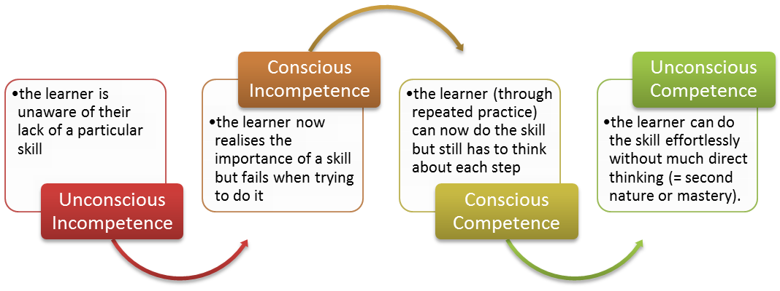
Competency level

Slide 9
Exercise – MRCGP components
Reliability vs Validity.

Slide 10
The Assessment Drives the Learning
For many students, assessment is not an educational experience in itself, but a process of ‘guessing what the teacher wants’.
McLaughlin & Simpson (2004)
An assessment can be a powerful way of making a trainee learn something – but do they engage in it with their hearts? And doesn’t it just cause unnecessary anxiety which can mask true performance?
The BIG question is how do we drive deep learning and not just teach to the test?
Is CPD, performance monitoring and feedback the way to go?

Slide 11
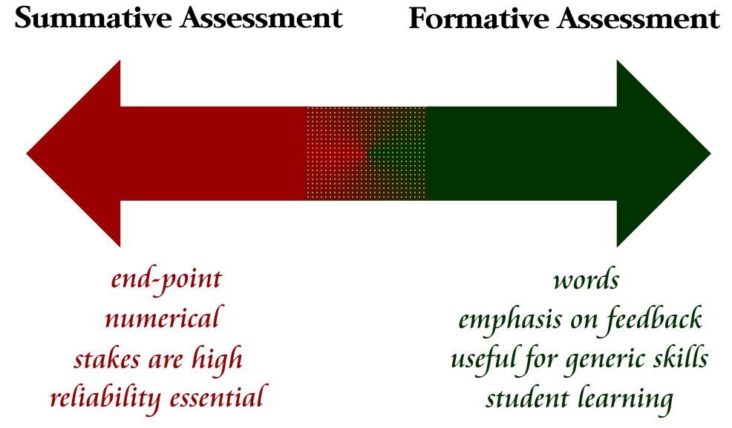
FORMATIVE & SUMMATIVE ASSESSMENT

Slide 12
Summative Assessment | Formative Assessment
Single process like an exam. | Continuous process that occurs throughout the training period.
Giving the learner a ‘ticket’ or certificate to proceed. | Is about helping the learner develop.
Results in a grade of competence. | Identifies strengths and weaknesses.
Results in a certificate or grade of competence. | Results in developmental feedback.
Often quite cold, remote and detached from teaching. | Results in a Personal Development Plan.
Is often seen as a negative process e.g. ‘Thank goodness the AKT is over.’ | Is seen as a positive process because it’s all about helping the trainee, not telling them off.
Examples in GP training: AKT, CSA, WPBA (COTs, mini-CEXs, CBDs etc) | Examples in GP training CS metings, ES meetings, PCA, RCA, Appraisal
Summative assessment is an assessment OF learning.
Formative assessment is an assessment FOR learning.
In summative assessment, the trainee tries to hide what they are bad at.
In formative assessment, they should be comfortable about displaying it.

